Slide 1


Default of credit card clients Data Science for Business AA Joana Ribeiro | Miroslav Sala | Ricardo Ferreira | Sara Ricardo | Slava Kholodov

Slide 2

Main questions to address
Prediction of likelihood of default
Forecasting with a high CP parameter
Selection of the best classifier
Feature engineering
Reflection on business decisions

Slide 3
The several models predict that neither of the customers will default
1
Prediction of likelihood of default
Approach
Reclassify numerical/integer data into categories
Exclude the two IDs to be predicted (ID 25001 & 26001)
Create testing and training samples
Develop forecasting models:
Stepwise regression
Ctree CART
Rpart CART
Cut-off for “default vs. non-default” set as the average of data, i.e., 0.2212
Compare models using the Confusion Matrix
Stepwise
Ctree CART
Rpart CART
AIC
n.a.
21795
n.a.
n.a.
Accuracy
0.816¹
0.779
0.819
0.819²
Ctree CART model is the one with the most reliable prediction given:
Higher accuracy
Higher AUC
Sensitivity
0.957¹
0.834
0.953
0.957²
Specificity
0.319¹
0.584
0.348
0.331²
AUC
0.638¹
0.771
0.773
0.677²
Prediction
ID25001: 0.12
ID26001: 0.14
No default
ID25001: 0.21
ID26001: 0.20
No default
ID25001 & 26001 0.17¹ / 0.14²
No default
1 CP = 0.0025
2 CP = 0.00068

Slide 4
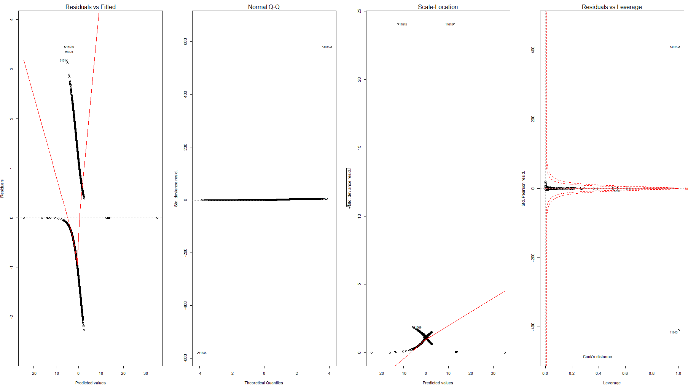
Output graphs for the stepwise logistic regression (1/2)
1
Stepwise logistic regression
All points, except for one, seem to be on the Normal Q-Q line which is a good indicator of the reliability of the model

Slide 5
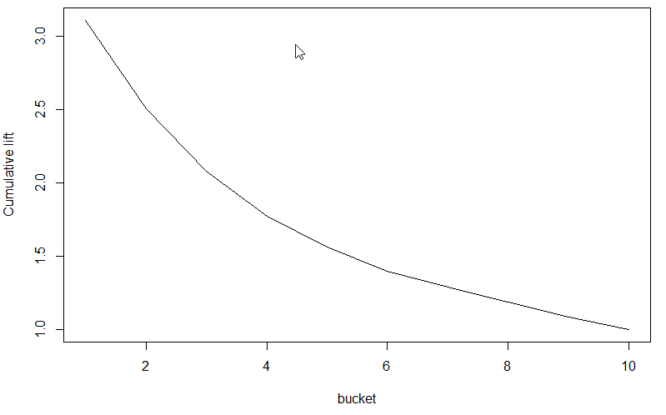
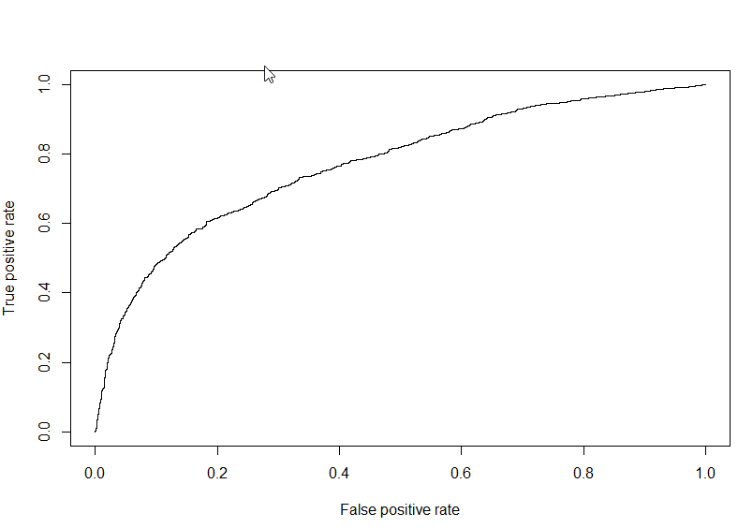
Output graphs for the stepwise logistic regression (2/2)
1
Stepwise logistic regression
Lift of over 3.0 is obtained for the top decile of customers
On average 22% of customers default, so for the a decile of the testing data, (~2500 clients) we expect ~553 to default
However, on the top decile, almost all 553 do not default, so the ROC curve is over 3.0
The AUC curve indicates that few mistakes are made for the “best” and “worst” customers

Slide 6
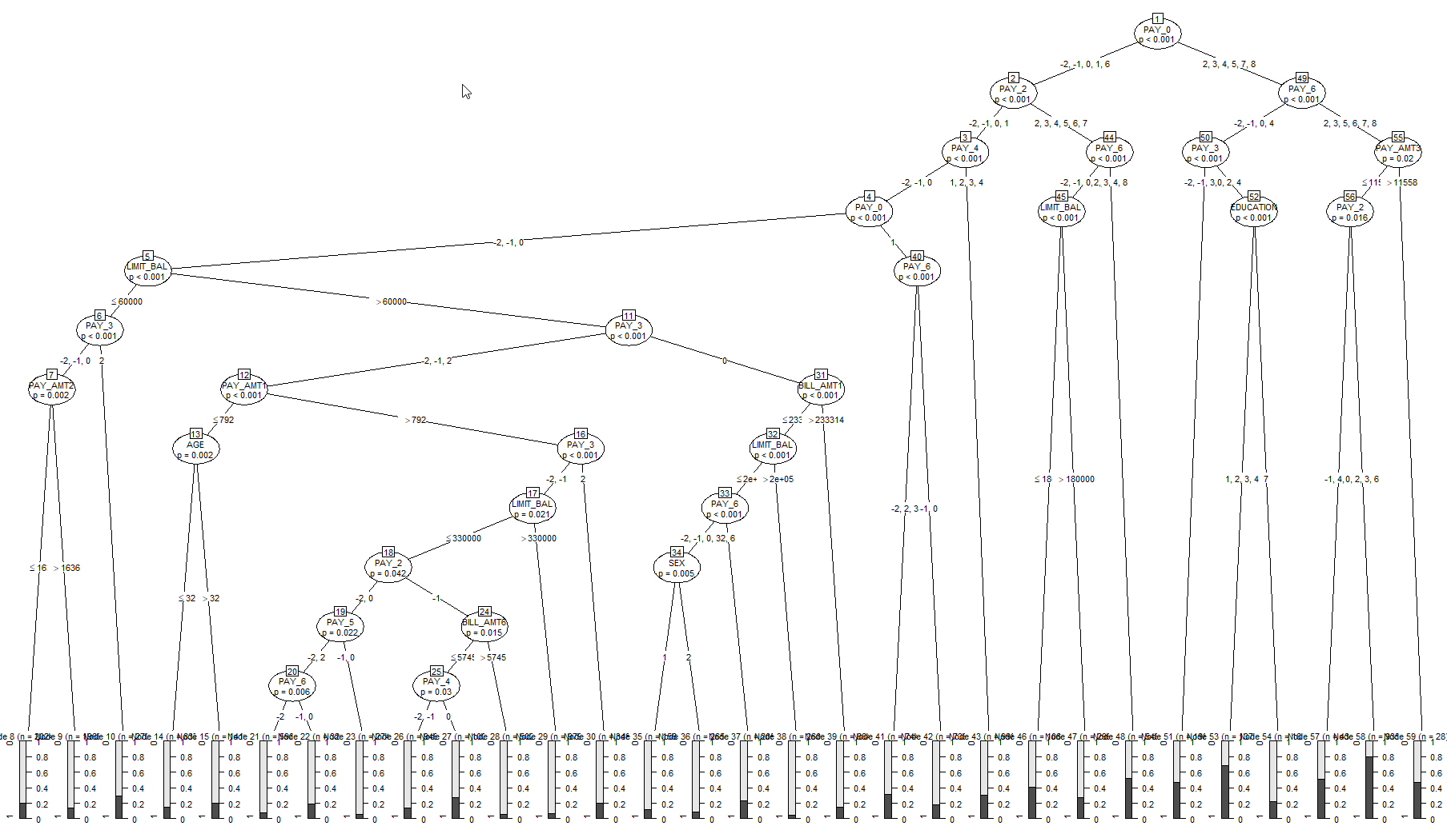
Output trees for the Ctree and Cpart models have different degrees of simplicity and prediction utility (1/3)
1
Ctree CART
The Ctree CART tree is complex, but represents the model with highest accuracy and AUC
Tree analysis is difficult to interpret, when compared with the regression equation

Slide 7
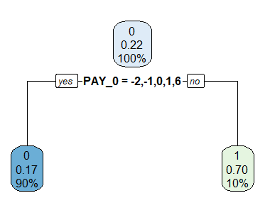
Output trees for the different models have different degrees of simplicity and prediction utility (2/3)
1
Rpart CART with CP = 0.0025
Rpart CART with CP = 0.0025 does not have enough detail (90% of customers fall in one bucket) so the forecasting power is low

Slide 8
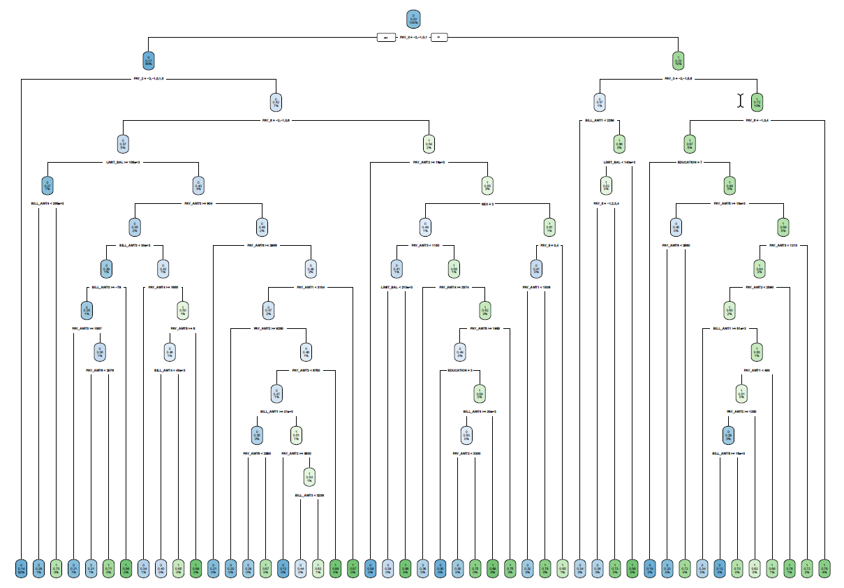
Output trees for the different models have different degrees of simplicity and prediction utility (3/3)
1
Rpart CART with CP = 0.00068
On the other hand, a Rpart CART with CP = 0.00068 has too much detail to be successfully implemented

Slide 9
Main questions to address
Prediction of likelihood of default
Forecasting with a high CP parameter
Selection of the best classifier
Feature engineering
Reflection on business decisions

Slide 10
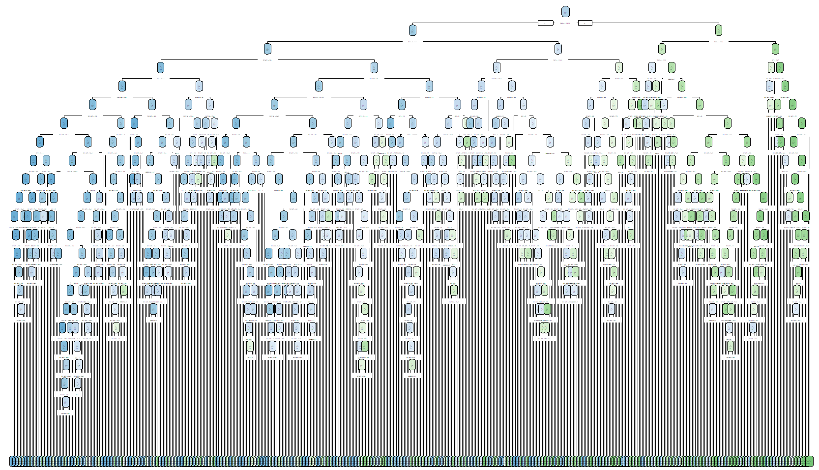
A Rpart CART with CP of 0.0001 is too truncated to be useful in predicting the default probability
2
Rpart CART tree with CP = 0.0001
Too granular model
Difficult to interpret
Overfit issue as seen in the summary table, as quality of the prediction drops significantly when comparing the performance on Training vs. Testing set
 | Training set | Testing set
Accuracy | 0.869 | 0.7909
Sensitivity | 0.9587 | 0.9093
Specificity | 0.5536 | 0.3738

Slide 11
Main questions to address
Prediction of likelihood of default
Forecasting with a high CP parameter
Selection of the best classifier
Feature engineering
Reflection on business decisions

Slide 12
We would choose cTree CART model for our business application as it yields best accuracy and AUC
3
Prediction of likelihood of default
Approach
Reclassify numerical/integer data into categories
Exclude the two IDs to be predicted (ID 25001 & 26001)
Create testing and training samples
Develop forecasting models:
Stepwise regression
Ctree CART
Rpart CART
Cut-off for “default vs. non-default” set as the average of data, i.e., 0.2212
Compare models using the Confusion Matrix
Stepwise
Ctree CART
Rpart CART
REMINDER
AIC
n.a.
21795
n.a.
n.a.
Ctree CART model is the one with the most reliable prediction given:
Higher accuracy
Higher AUC
Higher speed of the CTREE algorithm vs the logit regression
Though interpretation is less user friendly vs the Logit regression models
Accuracy
0.816¹
0.779
0.819
0.819²
Sensitivity
0.957¹
0.834
0.953
0.957²
Specificity
0.319¹
0.584
0.348
0.331²
AUC
0.638¹
0.771
0.773
0.677²
Prediction
ID25001: 0.12
ID26001: 0.14
No default
ID25001: 0.21
ID26001: 0.20
No default
ID25001 & 26001 0.17¹ / 0.14²
No default
1 CP = 0,0025
2 CP = 0,00068

Slide 13
Main questions to address
Prediction of likelihood of default
Forecasting with a high CP parameter
Selection of the best classifier
Feature engineering
Reflection on business decisions

Slide 14
New variables where included to increase the prediction power of the models…
4
Prediction of likelihood of default
New variables included
Repayment = PAY_mt / BILLED_AMT
Percentage usage = BILLED_AMT / LIMIT_MAX
Number of months over limit = Count of months where AMT_BILLED > LIMIT_MAX
Number of months not fully repaid = Count of months where AMT_PAID_{t+1} – AMT_BILLED_{t} < 0
Delta in credit outstanding (1, 2 and 3 months BILL_AMT_{t} - BILL_AMT_{t-1/t-2/t-3}
Stepwise
Ctree CART
Rpart CART
AIC
n.a.¹
21,816
n.a.
n.a.²
Accuracy
0.8155¹
0.7734
0.8175
0.8141²
cTree CART continues to be the model with the most reliable prediction given its (slightly) higher accuracy, despite its lower AUC vs. stepwise
Sensitivity
0.9566¹
0.8286
0.9520
0.9514²
Specificity
0.3186¹
0.5792
0.3439
0.3303²
AUC
0.6376¹
0.7720
0.7660
0.7011²
Prediction
ID25001: 0.12
ID26001: 0.13
No default
ID25001: 0.19
ID26001: 0.19
No default
ID25001 & 26001 0.17¹ / 0.13²
No default
1 CP = 0,0025
2 CP = 0,00068

Slide 15
…but the impact of the new variables did not improve the prediction power
4
Stepwise
Ctree CART
Rpart CART
AIC
n.a.¹
+21
n.a.
n.a.²
Accuracy
0¹
-0.0053
-0.0018
-0.0048²
Sensitivity
0¹
-0.0054
-0.0010
-0.0059²
Specificity
0¹
-0.0045
-0.0045
-0.0009²
AUC
0¹
0.0012
-0.0071
0.0238²
1 CP = 0,0025
2 CP = 0,00068

Slide 16
Main questions to address
Prediction of likelihood of default
Forecasting with a high CP parameter
Selection of the best classifier
Feature engineering
Reflection on business decisions

Slide 17
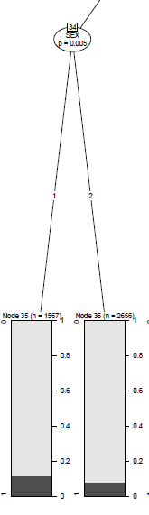
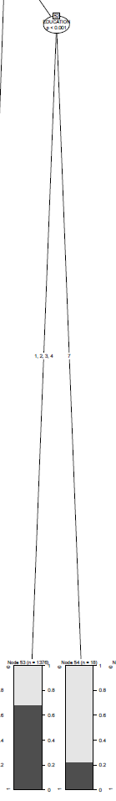
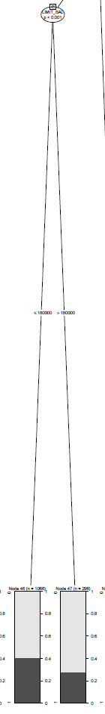
The flow of the Ctree CART model gives relevant information for the best and worst customer segments
4
Examples (samples from the Ctree CART tree)
Approach
Selection of Ctree CART model based on better accuracy and higher AUC
Analysis of the flow of the tree regarding
Customer segments
Impact of credit limits
Interpretation of critical factors when they are relevant for the prediction (i.e., when showing up as nodules)
Customer segments
Impact of credit limits
Impact on business decisions stemming from classification:
If default next month predicted, the bank can lower the limit on the credit card to limit the loss
Improved yield of the targeting of new customers based on the classification tree (offer new products to clients less prone to default)
Improved setting of card limit
Men appear to be slightly more likely to default
Education level seems relevant in predicting probability of default
Credit limits shows that the Bank has already learned with past experience, giving a lower limit to clients that are more prone to default

